Slide 1
ArcGIS Python API: Introduction to Scripting your Web GIS
Patrick Hammons

Slide 2
ArcGIS API For Python
Agenda
What it is
Who it’s for
What it can do for you
How to get it
Demo: quickstart
Demo: automating admin workflows
Hands-on:

Slide 3
ArcGIS API for Python
What is it?
Pythonic representation of your GIS
Powerful, modern and easy to use
Implemented using REST + local capabilities

Slide 4
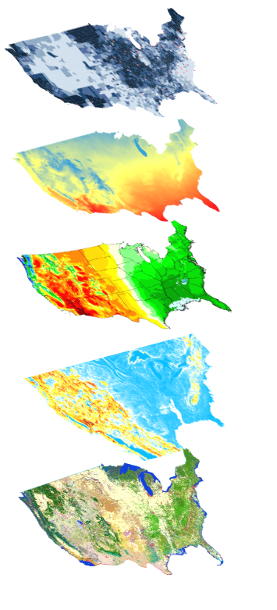
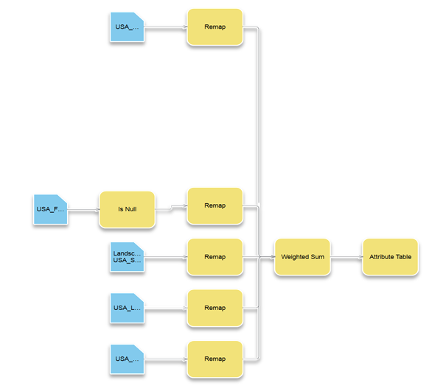
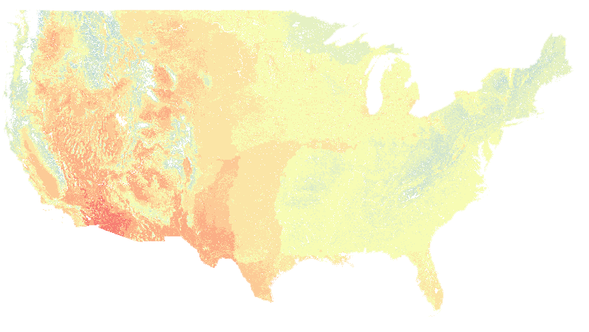

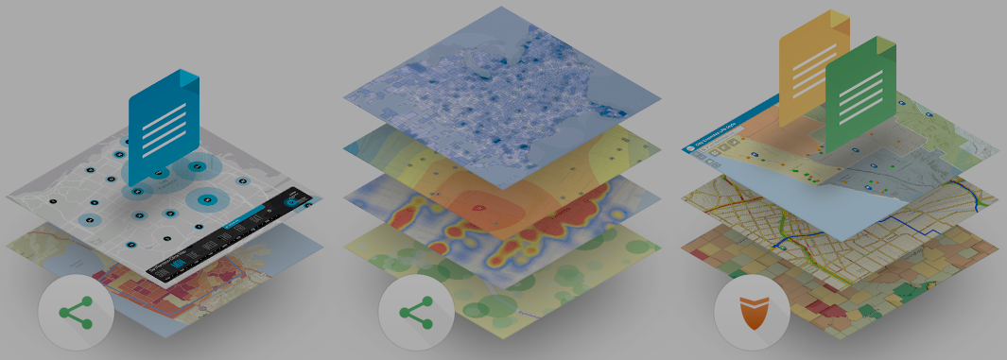
ArcGIS API for Python
Big Data
Spatial Analysis
Raster Analytics
Who is it for?
Imagery
Location Analytics
Feature Analytics
Platform API
Power Users
Developers
Analysts
Data Scientists
Enterprise Integration
Users, Roles & Group management
Administrators
DevOps
Content Publishers
Your Web GIS
Script and automate your Web GIS
Data Management

Slide 5
Automate WebGIS management
Reproducible research
What can it do for you?
Populate portal with users, groups
Clone portals
Reassign user content
Perform comprehensive content search
Determine item relationship
Create reports of users, their items
Access big data tools programmatically
Utilize rich 3rd party Python packages for data analysis
Create rich charts, graphs, embed 2D and 3D maps in Jupyter Notebook environment
Share your research with data and notes with peers
Automate content creation
Automate content publishing during off peak hours
Update tiles and features from a known database
Replicate development environment content to production
Inspect and update items with broken service links
Notes:
How can all 3 personas benefit from the API?
- Admins, instead of using the UI and getting distracted from their work, can automate most of their common workflows as scripts and schedule them to run at periodic intervals
- Publishers can take care of repetitive content creation and content validation workflows through scripts and schedule them to run at known times
- scientists all over in every discipline love the Jupyter notebook environment. We have added our own enhancements in the form of widgets. Analysts can prototype algorithms, inspect datasets, and visualize their datasets. They can finally share all their work, notes, outputs as Jupyter notebooks, or publish them as html pages to their blogs.

Slide 6
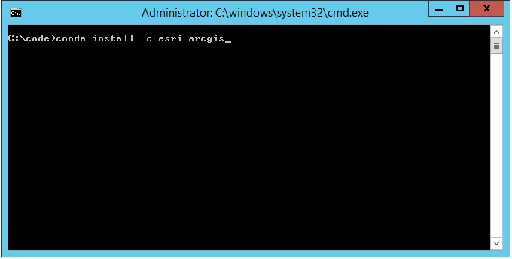
How do you get this?
Distributed via Conda
Simplifies installs & updates
Installs dependencies
Avoids conflicts
Install steps:
Download Anaconda
conda install –c esri arcgis

Slide 7

How do you get this?
Distributed via Conda
Simplifies installs & updates
Installs dependencies
Avoids conflicts
Install steps:
Download Anaconda
conda install –c esri arcgis

Slide 8
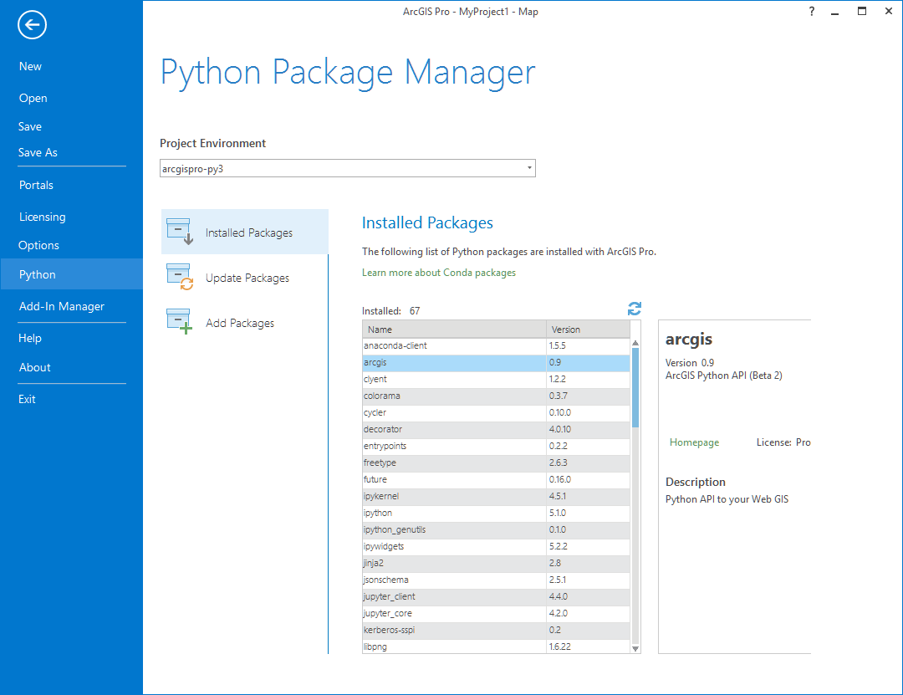
Have ArcGIS Pro?
ArcGIS Pro includes conda
Follow steps from install guide to install arcgis package...

Slide 9
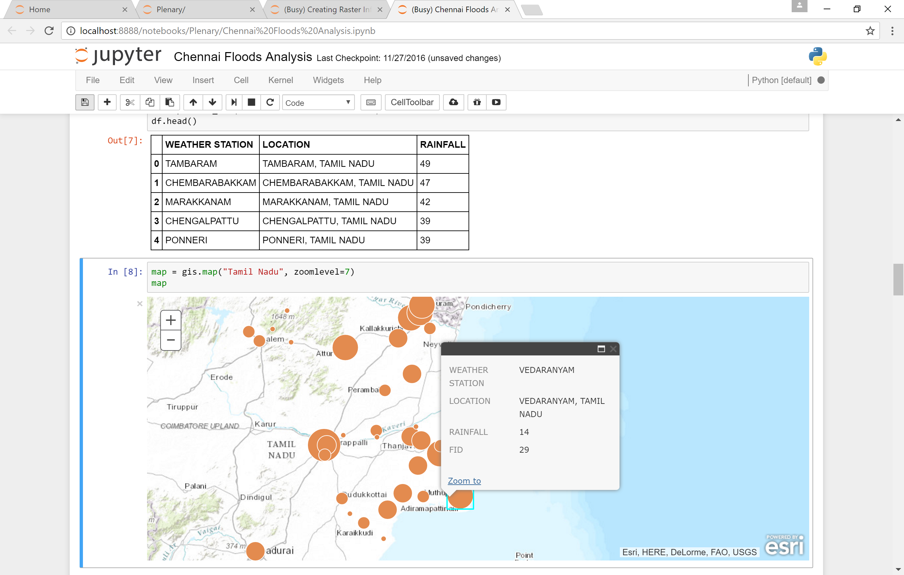
Demo Quick start
Notes:
Quickstart
Admin
HTML table to Pandas
Finding closest

Slide 10
Demo
Desktop
Apps
Automating administrative workflows with Python API
WebGIS Automation
Notes:
Quickstart
Admin
HTML table to Pandas
Finding closest

Slide 11
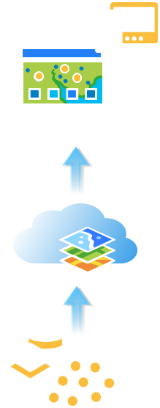
Hands-on
Content
Publishing
Materials: bit.ly/geodev-stuff
Credentials:
bit.ly/credential-checkout
Notes:
Quickstart
Admin
HTML table to Pandas
Finding closest

Slide 12
Hands-on
Content
Publishing
Overwriting Features with the Python API
Notes:
Quickstart
Admin
HTML table to Pandas
Finding closest

Slide 13
Hands-on
Interactive
Exploration
GIS Analysis
Analysis with Python API
Big Data GeoAnalytics
Spatial Analysis & Geoprocessing
Notes:
Quickstart
Admin
HTML table to Pandas
Finding closest

Slide 14
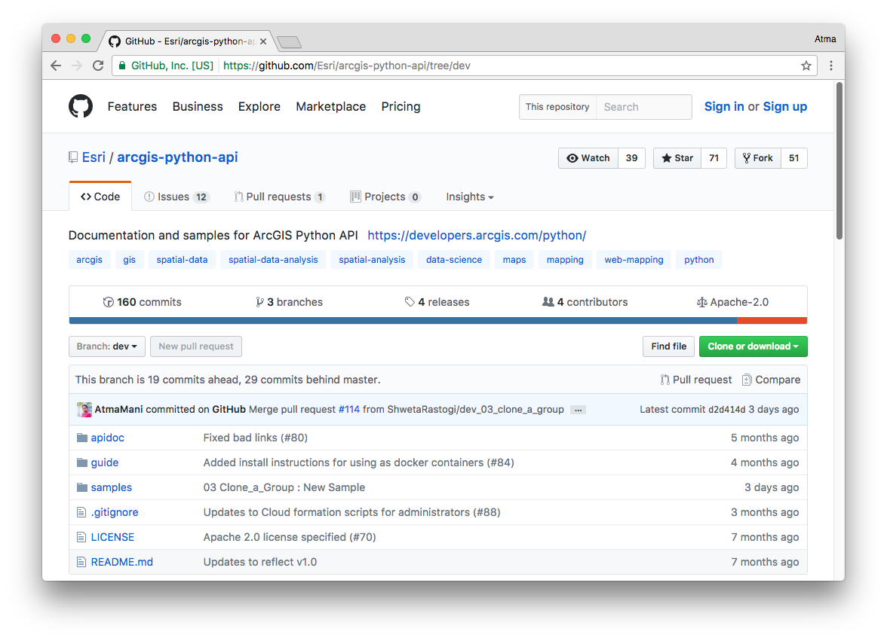
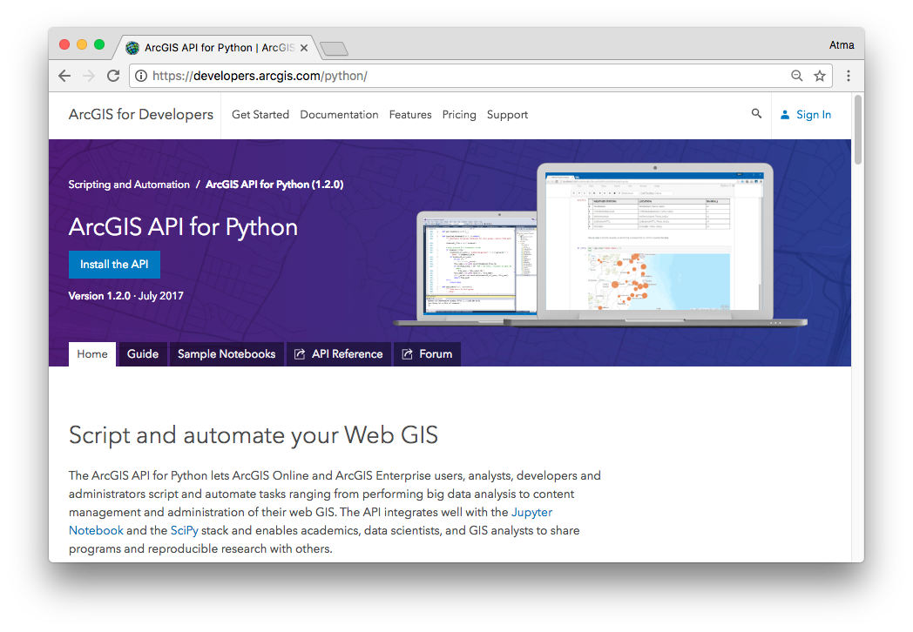
Resources
github.com/Esri/arcgis-python-api
developers.arcgis.com/python

Slide 15
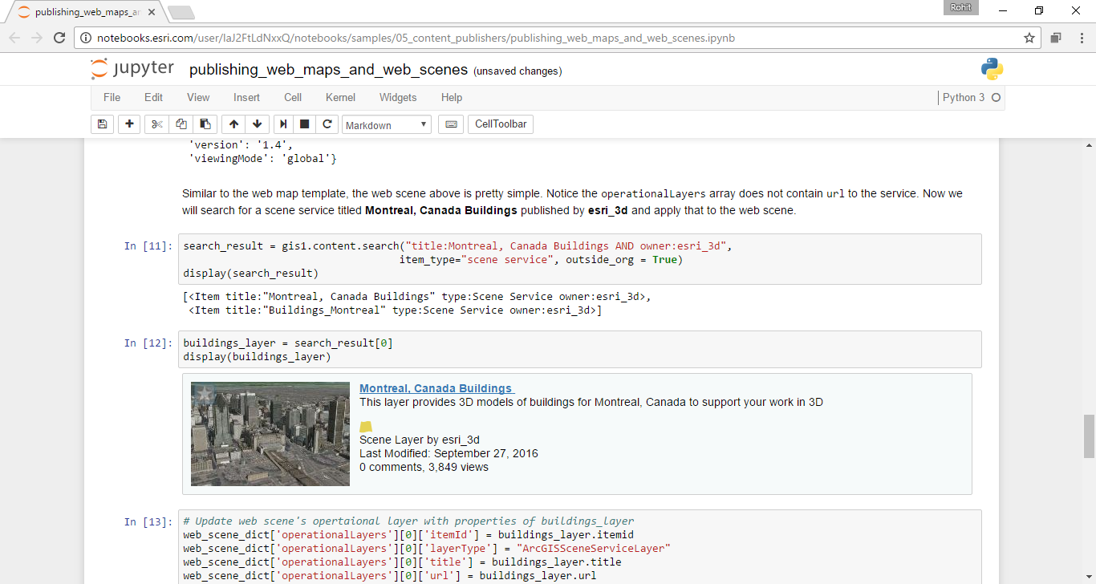
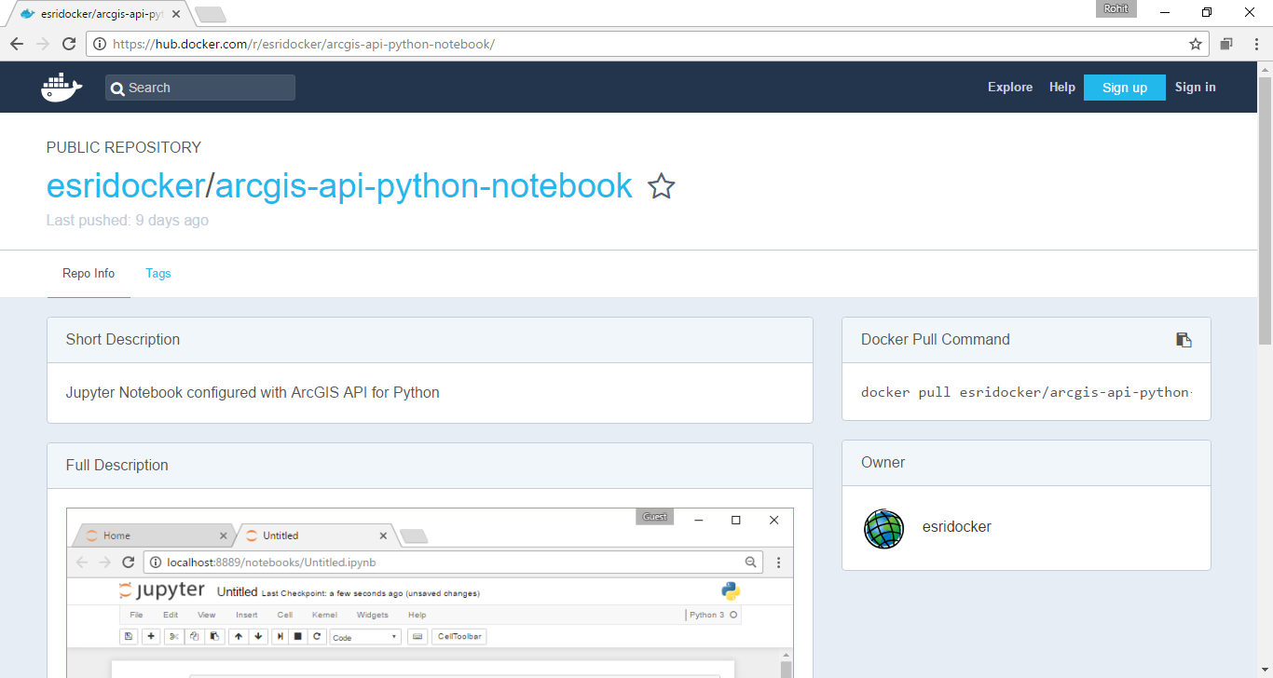
Resources
Notebooks.esri.com
hub.docker.com/r/esridocker

Slide 16
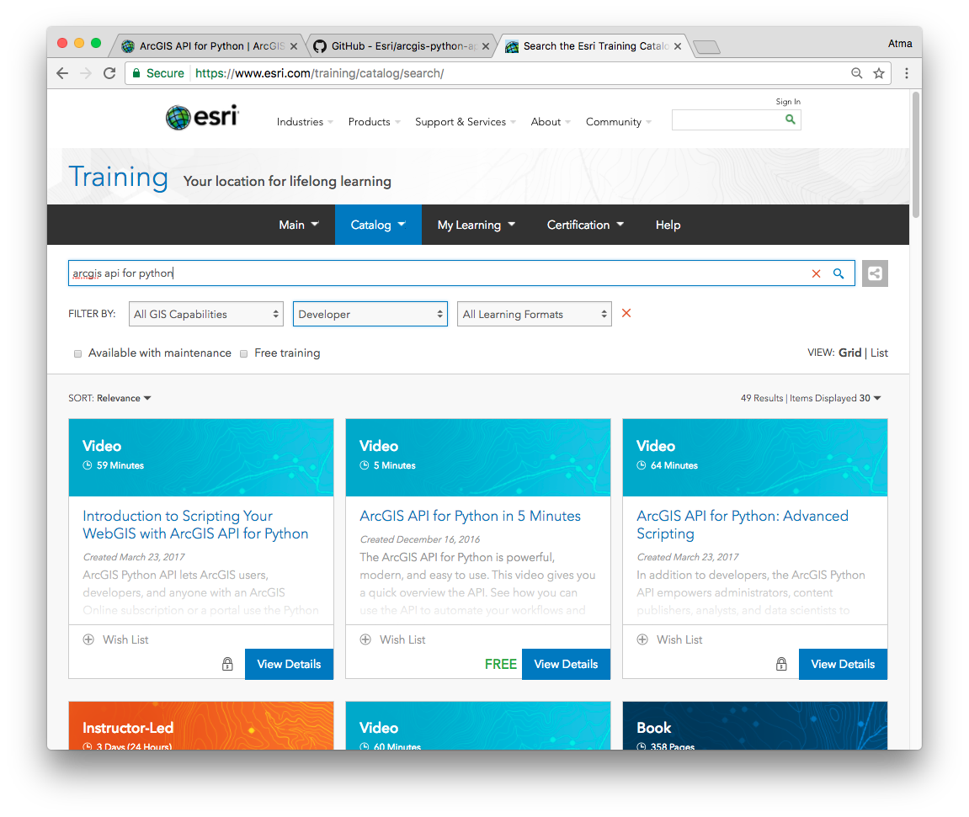
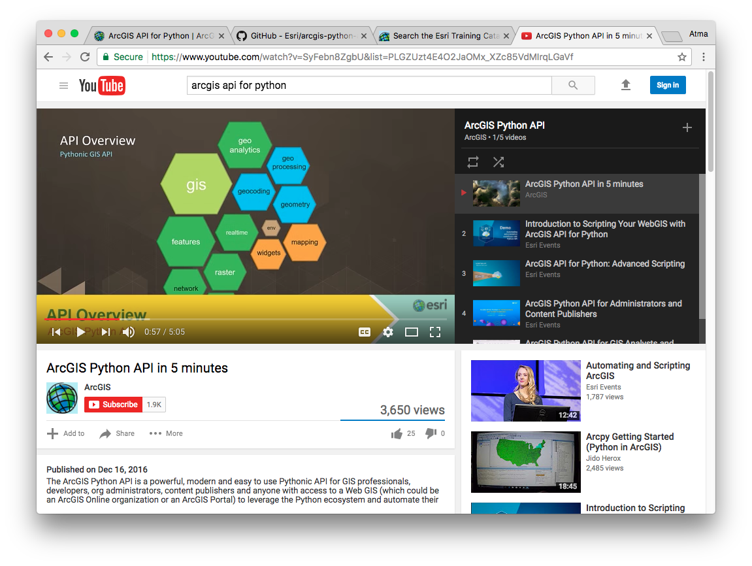
Resources
www.esri.com/training
youtube.com playlist

